Slide 1
20 anos do projeto perfSONAR
20 years of the perfSONAR project
Marcos Schwarz (Moderador / Moderator)
Gerente de P&D em Ciberinfraestrutura
Cyberinfrastructure R&D Manager

Slide 2

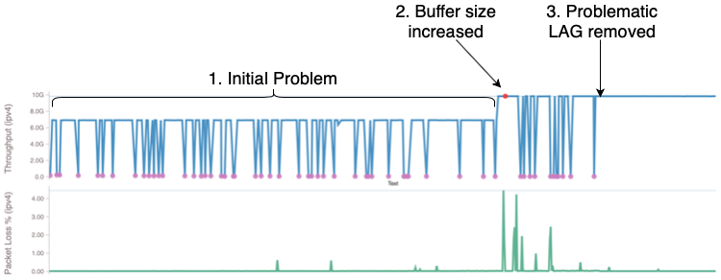
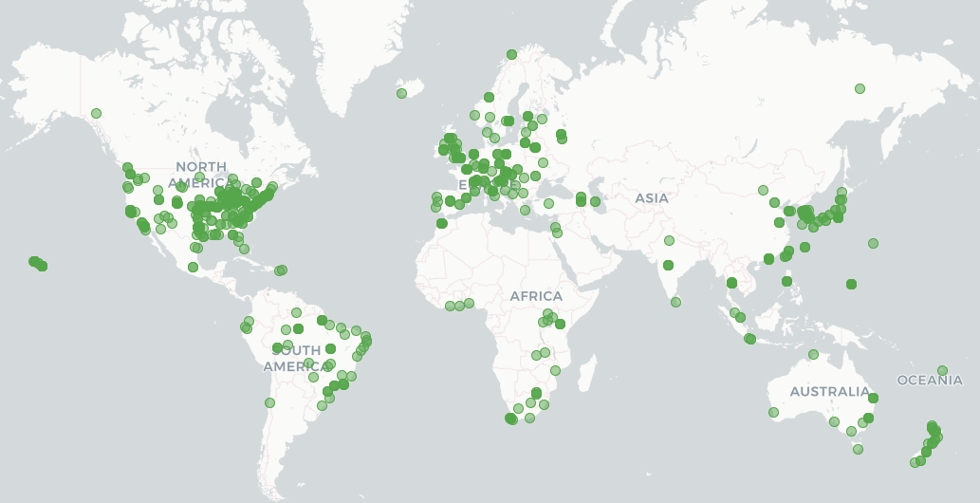
perfSONAR is an open source software suite that runs, stores and displays active measurements such as throughput, packet loss, latency and traceroute
Primarily maintained by consortium of ESnet, GEANT, Indiana University, Internet2, RNP and the University of Michigan
Over 2000 registered public deployments around the world across hundreds of institutions
Graph of low throughput from Pan-STARRS Hawaii to Queen’s University Belfast
Example perfSONAR use cases:
Solving global network performance issues for for researchers transmitting data international collaboratoins
Identifying packet loss issues
Identifying performance bottlenecks as Large Hadron Collider (LHC) prepares for the “high luminosity” era
Map of perfSONAR deployments around the globe
Notes:
USE THIS SLIDE WHEN PROVIDING GENERAL INTRO TO PERFSONAR
Explanation of graph:
PANSTARRS Hawaii to Queen’s Unversity - Researchers initially reported low throughput when running a transfer from Hawaii to Belfast. Such a long path involved multiple networks. The institutions along this path were all running perfSONAR and were able to use that information to narrow it down to a segment in the UK. The first part of the graph shows the problem of both los throughout and widely varying throughput. The first problem they found was an undersized buffer that increased throughput ceiling but packet loss and dips remained (2). They then found a single LAG giving errors, removed it from aggregation and results stabilized (3)

Slide 3

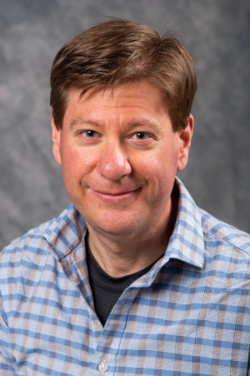
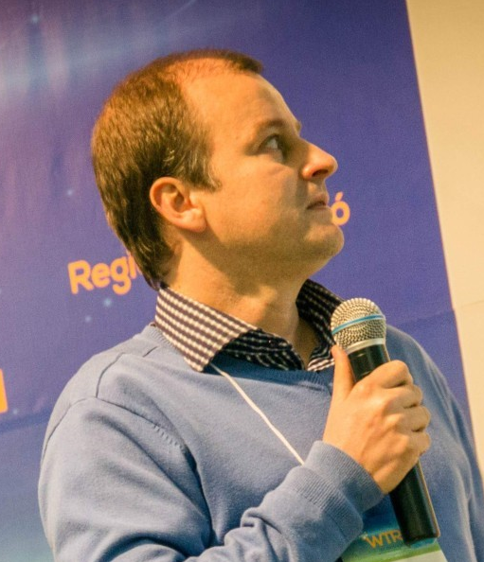
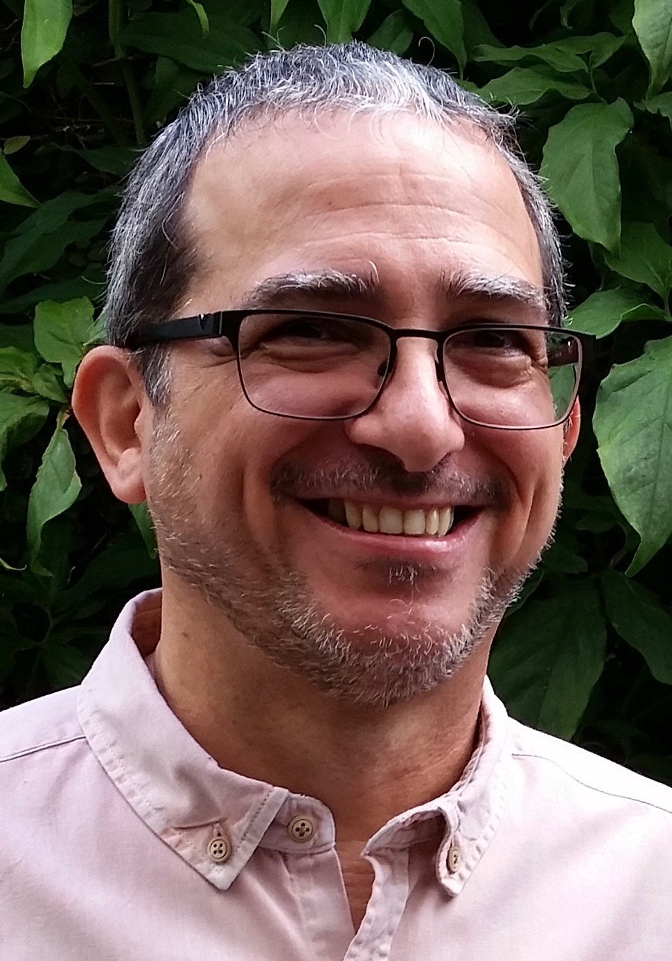
Guilherme Eliseu Rhoden
PoP-SC/RNP
Jason Zurawski
ESnet
José Augusto Suruagy
CESAR

Slide 4
Jason Zurawski
Mini-bio
Science Engagement Engineer at the Energy Sciences Network (ESnet) in the Scientific Networking Division of the Computing Sciences Directorate of the Lawrence Berkeley National Laboratory. ESnet is the high performance networking facility of the US Department of Energy Office of Science. ESnet's mission is to enable those aspects of the DOE Office of Science research mission that depend on high performance networking for success. Jason's primary responsibilities include working with members of the research community to identify the role of networking in scientific workflows, evaluate current requirements, and suggest improvements for future innovations. Jason has worked in computing and networking since 2004, and has a B.S. in Computer Science & Engineering from The Pennsylvania State University earned in 2002, and an M.S. in Computer and Information Science from The University of Delaware earned in 2007. He has previously worked for the University of Delaware and Internet2.

Slide 5
José Augusto Suruagy
Mini-bio
PhD in Computer Science from UCLA, 1990. He is currently a professor at CESAR School and a visiting professor at the Computer Science Center of UFPE. He has research experience in architecture, traffic engineering, monitoring, quality of service, and security in computer networks. He coordinated several RNP working groups on quality of service and monitoring from 2002 to 2007, the MonIPÊ Experimental Service from 2008 to 2011, as well as the Technical Committee on Network Monitoring (CT-Mon) from 2011 to 2013. Life Senior Member of the IEEE. In 2014, he received the Outstanding Achievement Award from the Brazilian Symposium on Computer Networks and Distributed Systems (SBRC) and in 2019 the Newton Faller Award from SBC, especially for his work with the Forum of Graduate Coordinators in Computer Science.

Slide 6
Guilherme Eliseu Rhoden
Mini-bio
Guilherme Eliseu Rhoden holds a Master's degree in Computer Science from UFSC (2002), a Specialist in Information Technology Governance from UNISUL (2017) and a Bachelor's degree in Computer Science from UFPEL (1999). He has been a network analyst at PoP-SC/RNP since 2003 and is currently the technical coordinator of PoP-SC/RNP and PTT/SC. He is the leader of the RNP Anycast DNS project, called EduDNS. He has participated in several research groups, such as GT-QoS, GT-Medições, MONIPÊ and Projeto FUTURA RNP (MonCircuitos), and was the technician responsible for the implementation of REMEP-FLN, PARC Blumenau and Fone@RNP 2012-2017.

Slide 7
What’s Next?
perfSONAR Releases
  5.x brought many architecture changes (archiver/Grafana)
  5.2.0 coming in the following months (beta since march)
Make it easier
  Updated trainings that focus on the new pieces
  Continue to update documentation and add better guides
Leverage the changes of the last few years
  Improve Alerting, Analysis, Visualization, Correlation with other data (e.g. Flow, SNMP/Streaming telemetry)
  Explore new ways to enable researchers to use the data

Slide 8
20 anos do projeto perfSONAR
Acompanhe as Iniciativas Relacionadas
Movimentação de dados 100Gbps+
Salão de Exposição
Dados de Rede para Pesquisa
Salão de Exposição
Palco Inova – 19/05 14h
MonIPÊ - Homologações & Medições
Salão de Exposição
Palco Inova – 20/05 15h

Slide 9
Q&A

